Slide 1

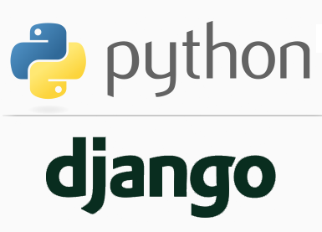
FULL STACK WEB DEVELOPMENT WITH DJANGO
Lecture 15

Slide 2

Today’s Agenda
Developing Our Django App
Django Models
Example

Slide 3
Drawbacks Of Traditional Way Of DB Programming
Although we were able to fetch records from the DB and show them in our template , but this approach has 3 drawbacks:
We’re hard-coding the database connection parameters in our view. If in future the passwords or username change then we will have to change it in every view which will be redundant and cumbersome. Ideally, these parameters should be stored in the Django configuration.
We’re having to write a fair bit of boilerplate code: creating a connection, creating a cursor, executing a statement, and closing the connection. This all can be easily taken care of by Django and we just have to specify what results we want.

Slide 4
Drawbacks Of Traditional Way Of DB Programming
Currently we are using Oracle , but if in future we switch from Oracle to MySQL, then, we’ll have to use a different database adapter (e.g., MySQLdb), alter the connection parameters, and – depending on the nature of the SQL statement – possibly rewrite the SQL , which again is very cumbersome and difficult
As you might expect, Django’s database layer aims to solve these problems.

Slide 5
Drawbacks Of Traditional Way Of DB Programming
To understand power of Django’s database layer , here is a sneak preview how the previous view can be rewritten using Django’s database API:
from django.shortcuts import render_to_response
from dbapp1.books.models import Book
def book_list(request):
bookrecords = Book.objects.order_by('name')
context={'records':bookrecords}
return render(request,'dbapp1/showbooks.html',context)

Slide 6
Django’s Database Layer
Django’s database layer contains 2 important components which are:
Models
ORM
Together these 2 components make it very easy for us to interact with the database.

Slide 7
Introduction To Model
Model in Django is a class imported from the django.db library that acts as the bridge between our database code and the db server.
This class is a representation of the data structure used by our website.
It will directly relate this data-structure with the database so that we don’t have to learn SQL for the database.

Slide 8
Introduction To Model
In simple words, a Model allows us to do following things:
Create tables and define relationships between them.
Modify tables and relationships between them.
Access data stored in tables using Django ORM (without writing raw SQL).

Slide 9
Introduction To ORM
The term ORM stands for Object relational Mapping
We know that every database implements SQL in a different way, because they all are made to complete a different task and this creates a bit of a problem for the developers, for example:
Suppose you know Oracle very well, but what will you do if your task can only be achieved by MongoDB?

Slide 10
Introduction To ORM
Now , you can’t invest your time in understanding the new database and also trying to figure out how to integrate your server with the database.
This problem is handled by Django ORM, which is a great tool and provides you with the ability to write python data-structures instead of a database language.

Slide 11
Understanding ORM
ORM is a powerful programming technique that makes working with data and relational databases much easier.
An ORM tool provides a simple mapping between an Object (the ‘O’ in ORM) and the underlying database.
This means that the programmer doesn’t need to know the database structure, nor does it require complex SQL to manipulate and retrieve data

Slide 12
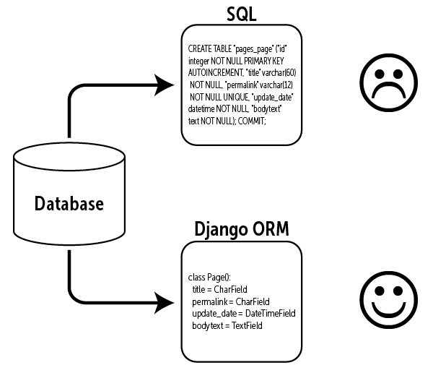
Understanding ORM

Slide 13
Understanding ORM
In Django, the model is the object that is mapped to the database.
When we create a model, then automatically Django executes SQL to create a corresponding table in the database , without us having to write a single line of SQL.

Slide 14
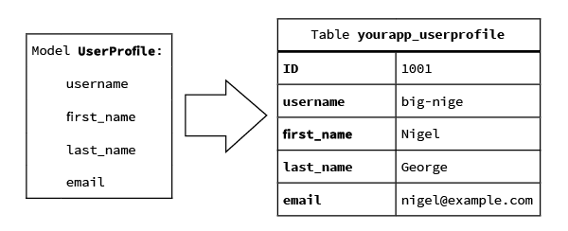
Understanding ORM

Slide 15
Understanding ORM
In the next figure a second model is created to keep track of the courses a user is enrolled in.
Repeating all the user’s information in the table yourapp_Course would be against good design principles, so we instead create a relationship (the ‘R’ in ORM) between the yourapp_Course table and the yourapp_UserProfile table.

Slide 16
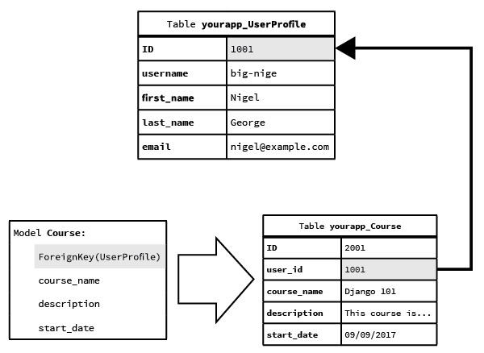
Understanding ORM

Slide 17
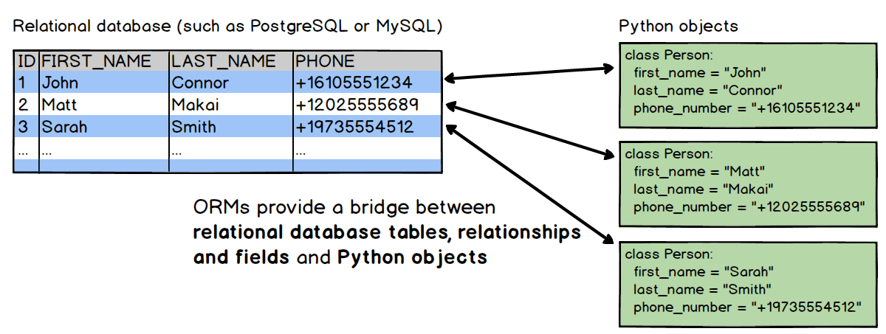
Understanding ORM

Slide 18
Supported Databases
Django officially supports four databases:
PostgreSQL
MySQL
SQLite
Oracle
There are also several third-party applications available if we need to connect to an unofficially supported database.

Slide 19
Supported Databases
Initially we will be using SQLite and then Oracle , because Django installs and configures SQLite automatically, with no input from our side

Slide 20
How To Use Models ?
To use models in our program we will have to do the following:
Activating Django Environment in VS Code
Creating a Django Project in VS Code
Creating the app
Activating the app
Create the templates directory structure.
Configuring settings.py for templates
Defining the model
Syncing it with the database
Accessing the model in the view
Rendering the model from view to template
Create the HTML file inside the template directory for accessing model data
Configuring the View in Url
Running the server
Opening the page in browser

Slide 21
Steps Needed For Using Models
As we can observe , all the steps are same except 3 new steps which are :
Defining the Model
Syncing it with the database
Accessing the Model

Slide 22
Performing Initial Steps
Create a folder called mytenthvsdjangoproject in djangoexamples.
Load it in the VS CODE
Create a django project called modeldemoproj1 by using the command:
django-admin startproject modeldemoproj1
This will create the outer project folder called modeldemoproj1 and inner app folder also by the same name

Slide 23
Performing Initial Steps
Now go to the outer project folder modeldemoproj1 and create an app called modeldemoapp1 by using the command:
django-admin startapp modeldemoapp1
Now create a folder called templates in the outer project folder called templates and inside templates create a folder called modeldemoapp1 and within it create a file called showbooks.html
Finally update settings.py so that it contains the name of our app and the template directory path

Slide 24
Performing Initial Steps
Code:
INSTALLED_APPS = [
'django.contrib.admin',
'django.contrib.auth',
'django.contrib.contenttypes',
'django.contrib.sessions',
'django.contrib.messages',
'django.contrib.staticfiles',
'modeldemoapp1',
]

Slide 25
Performing Initial Steps
Code:
TEMPLATES = [
{
'BACKEND': 'django.template.backends.django.DjangoTemplates',
'DIRS': [os.path.join(BASE_DIR,'templates')],
…..
}

Slide 26
Steps For Using Model
After doing the initial required steps ( 1 to 6) we now need to perform steps for using models
For this we just have to perform 3 extra steps which are:
Defining the Model
Syncing it with the database
Accessing the Model

Slide 27
Step 7-Defining The Model
To create/define a Model , we simply have to create a class with the following key features:
It should be created in the file models.py of our app
It should inherit Django’s built in class models.Model
The name of the class will become the name of the table.
It should contain same number of fields defined at the class level as we want columns in the table

Slide 28
Step 7-Defining The Model
As the first example , we will be creating a Book Model to represent Book table in the database.
Following is the structure we want for our Book table
Column Name | Data Type | Description
Book_id | Number | To store unique book id
Book_name | Varchar2 | To store name of the book
Book_price | Number | To store price of the book
Subject | Varchar2 | To store subject name of the book
Pub_date | Date | To store date of publishing

Slide 29
Step 7-Defining The Model
Now ,we must convert this Table into a Model , but before doing that we must understand the data types which Django provides to be used for fields/columns of our Model/Table.
Django provides us built in classes called Field Types to be used as data types for our Model fields.
Although Django provides 29 field types but in the next slide we have listed the most common of them

Slide 30
Step 7-Defining The Model
Class Name | Description
CharField | A Field for storing small to medium-sized string upto 255 characters.It acts as a base for other string-based fields. It doesn't provide any validation
TextField | A field to store a large amount of text. Use this field to store the content of blog post. In Python, this field translates to string. In databases, it translates to TEXT field. Like CharField this field doesn't provide any validation
IntegerField | A field to store integer values from -2147483648 to 2147483647. It checks whether the value entered is number or not.

Slide 31
Step 7-Defining The Model
Class Name | Description
FloatField | It is a floating-point number represented in Python by a float instance.
BooleanField | A field to store True or False. In the context Python, it translates to boolean True and False. In the context of the database (as we are using SQLite) it is stored as an integer (1)True and (0) False. Remember SQLite has integer type to handle integers.
EmailField | A CharField that checks that the value is a valid email address
URLField | A CharField used to store URL. It provides validation.

Slide 32
Step 7-Defining The Model
Class Name | Description
FileField | It is a file-upload field.
DateField | A Field to store date. It corresponds to Python's datetime.date instance. It doesn't inherit from CharField. It provides validation.
TimeField | A time, represented in Python by a datetime.time instance.
DateTimeField | Creates a datetime field to store dates with times.
ImageField | Inherits all attributes and methods from FileField, but also validates that the uploaded object is a valid image.

Slide 33
Step 7-Defining The Model
A Sample Model:
class Person(models.Model):
first_name = models.CharField(max_length=30)
last_name = models.CharField(max_length=30)
age=models.IntegerField()
birth_date=models.DateField()
The above code creates a Person Model with 4 fields called first_name , last_name , age and birth_date.
As you can observe the CharField requires one extra argument called max_length , for specifying the maximum length (in characters) of the field

Slide 34
Step 7-Defining The Model
Now let’s turn our table into a Django model and for this follow the steps mentioned below:
Open the models.py file in our modeldemoapp1 folder and add the following model code:
modeldemoapp1/models.py
from django.db import models
class Book(models.Model):
book_id=models.IntegerField()
book_name=models.TextField()
book_price=models.FloatField()
subject=models.CharField(max_length=30)
pub_date=models.DateField()

Slide 35
Step 7-Defining The Model
Let’s have a closer look at our first model:
Line 1: imports the models package from django.db. If we use the command startapp, this line will already be in our file.
Line 2: is the Book class definition. Each Django model must inherit from Django’s Model class.

Slide 36
Step 7-Defining The Model
Each of our model fields has a related Django field type .
The Book model uses five different field types – IntegerField,FloatField,TextField,CharField and DateField

Slide 37
Step 7-Defining The Model
Let’s have a look at the field types and options in more detail:
Line 3: The book_id field is a Django IntegerField which can store values between the range -2147483648 to 2147483647
Line 4: The book_name field is a Django TextField. A TextField is a large text field that can hold many thousands of characters (maximum depends on the database)
Line 5: The book_price field is a Django FloatField which can allow us to store float values .
Lines 6 : The subject field is a Django CharField . A CharField is a short line of text (up to 255 characters). In this case, the max_length option sets the maximum length of the subject to 30 characters
Line 7: The pub_date is a Django DateField. A DateField records a Python datetime.date object

Slide 38
Step 8-Syncing Model With The DB
Now that we’ve created the model, it’s time to add it to the database.
This is done using migrations.
In Django, database migrations usually go hand in hand with models: whenever we code up a new model, we also generate a migration to create the necessary table in the database.

Slide 39
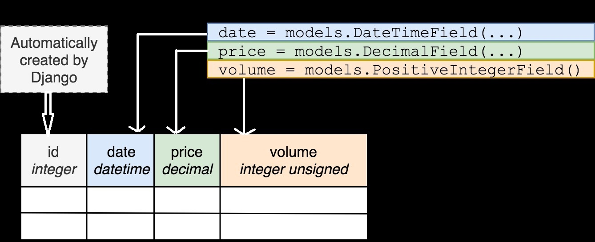
Step 8-Syncing Model With The DB
Here’s an example of how a Django model class is migrated to a database table:

Slide 40
Step 8-Syncing Model With The DB
But just defining a model class in a Python file does not make a database table magically appear out of nowhere.
Creating the database tables to store our Django models is the job of database migration.
Additionally, whenever we make a changes to our models, like adding a field, the database has to be changed too. Migrations handle that as well.

Slide 41
Step 8-Syncing Model With The DB
Performing migration is a 2 step approach:
Creating migrations
Applying migrations

Slide 42
Step 8-Syncing Model With The DB
Creating Migrations
With the model created, the first thing we need to do is create a migration for it. We can do this with the following command:
python manage.py makemigrations <name of app>
makemigrations basically generates the SQL commands for apps' model which we add in installed apps.
It does not execute those commands in our database file.
So tables don't get created after makemigrations.

Slide 43
Step 8-Syncing Model With The DB
Applying Migrations
After running makemigrations we need to execute SQL commands at the database and this is done using the command migrate as shown below:
python manage.py migrate <name of the app>
So after executing migrate all the tables of our installed apps are created in our database file.

Slide 44
Step 8-Syncing Model With The DB
Now that we’ve created the Book model, we should now sync it with the database using migrations.
Make sure the virtual environment is running and then change into the modeldemoproj1 directory.
From the VS command prompt, run:
python manage.py makemigrations modeldemoapp1
Hit enter, and then run:
python manage.py migrate modeldemoapp1

Slide 45
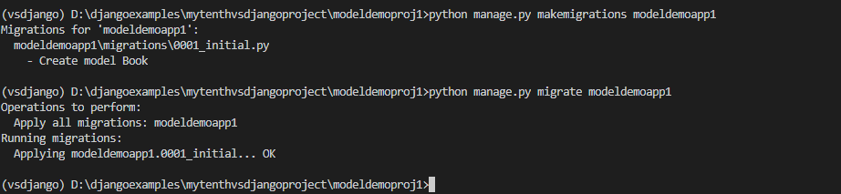
Step 8-Syncing Model With The DB

Slide 46
Checking Out Our Tables
We can confirm this by installing sqlite browser and opening the file db.sqlite3 .
We can see all the tables appears in the database file after executing migrate command.
The image is shown on the next slide

Slide 47
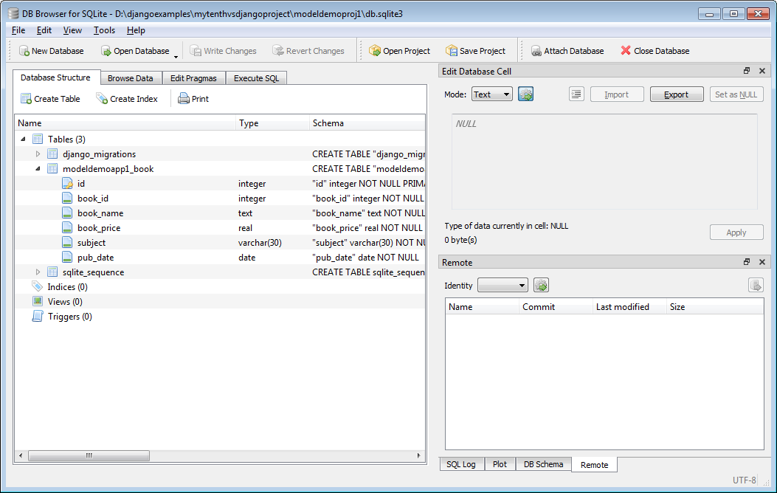
Checking Out Our Tables

Slide 48
Step 9-Accessing The Model
After we have synced the model with the database , our next task is to perform CRUD ( Create , Read , Update and Delete) operations on it from the view.
Initially we will learn how to add and retrieve records from the database use Django’s database API and then we will lean other operations

Slide 49
Step 9-Accessing The Model
Adding Records In The DB:
For adding records in the database through our view function , we have to take following steps:
Import the required model
Create an instance of the model class and then initialize it by passing the data as key-value pair where key name will be column name as set in the model class and value will be the data we have passed.
Call the save( ) method using the model object. This method is inherited from the class models.Model in our model class.

Slide 50
Step 9-Accessing The Model
Let’s assume we have a model called Student with the data members as name, roll and per.
So , to insert an instance of this model in our table , we would write the following code in the view
from school.models import Student
def addStudentView(request):
st = Student(name = "Ravi", roll = 15,per=67.8)
st.save()

Slide 51
Step 9-Accessing The Model
Retrieving Records From The DB:
To retrieve students from the database, we have to use the attribute Student.objects.
We can think it to be a set of all students
To fetch a list of all Student objects in the database with the statement Student.objects.all().
Behind the scenes, Django executes an SQL SELECT statement here.

Slide 52
Step 9-Accessing The Model
Continuing with our previous example , let’s assume that we have stored multiple student objects into the database and now we want to retrieve them
So , to do this , we would write the following code in the view
from school.models import Student
def getAllStudentView(request):
total_students=Student.objects.count()
all_students=Student.objects.all()

Slide 53
Step 9-Accessing The Model
The statement Student.objects.count() will return total number of records in the database
The second statement Student.objects.all() will return a set of Student objects
This set is an object of the class QuerySet in Django
A QuerySet is an iterable collection of objects of a given Model and allow us to read the data from the database, filter it and order it.

Slide 54
Step 9/10-AccessingRendering The Book Model
Based on our previous discussion , try to add and retrieve records from database using our Book model.
Following are the steps needed :
Go to views.py and create 2 views named addBooksView() and getBooksView().
The function addBooksView() will add 3 book records to the database with the following values:
book_id | book_name | book_price | subject | pub_date
101 | Let Us C | 250.0 | C | 2001-01-15
102 | Mastering Python | 450.0 | Python | 2014-10-21
103 | Python Projects | 350.0 | Python | 2016-04-09

Slide 55
Step 9/10-AccessingRendering The Book Model
It will then retrieve number of books in the database and redirect the request to the template result.html along with the book count
The function getBooksView() will retrieve all the books from the database , pack them in a list called book_list and redirect the request to the template showbooks.html along with the list book_list

Slide 56
Step 9/10-AccessingRendering The Book Model
views.py
from django.shortcuts import render
from modeldemoapp1.models import Book
def addBooksView(request):
book1=Book(book_id=101,book_name="Let Us C",book_price=250.0,subject="C",pub_date="2001-01-15")
book1.save()
book2=Book(book_id=102,book_name="Mastering Python",book_price=450.0,subject="Python",pub_date="2014-10-21")
book2.save()
book3=Book(book_id=103,book_name="Python Projects",book_price=350.0,subject="Python",pub_date="2016-04-09")
book3.save()
total_books=Book.objects.count()
context={'count':total_books}
return render(request,"modeldemoapp1/result.html",context)

Slide 57
Step 9/10-AccessingRendering The Book Model
def getBooksView(request):
all_books=Book.objects.all()
book_list=[]
for b in all_books:
book_list.append(b)
context={'book_list':book_list}
return render(request,"modeldemoapp1/showbooks.html",context)

Slide 58
Step 11- Designing The Template
Now we will have to code result.html and showbooks.html pages in templates directory.
The page result.html will be loaded when the user visits root location and simply show the message that books have been added to the database along with the total number of books

Slide 59
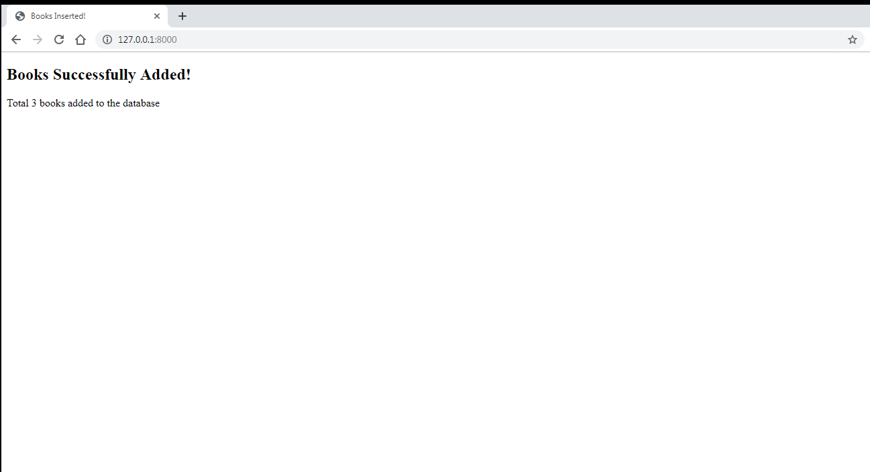
Step 11- Designing The Template
Following is the desired output of result.html:

Slide 60
Step 11- Designing The Template
Following is the code of result.html:
<!DOCTYPE html>
<html lang="en">
<head>
<title>Books Inserted!</title>
</head>
<body>
<h2>Books Successfully Added!</h2>
Total {{count}} book{{count|pluralize}} added to the database
</body>
</html>

Slide 61
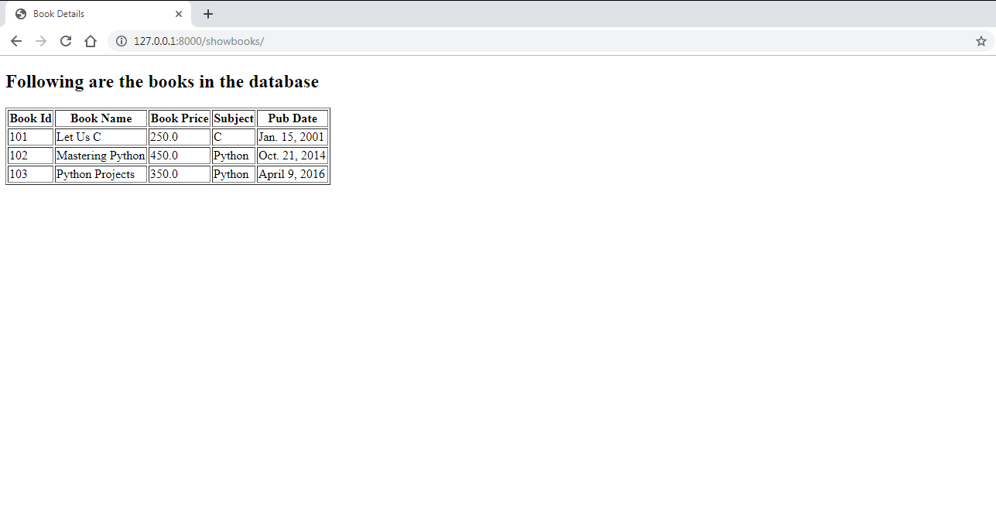
Step 11- Designing The Template
The page showbooks.html will be loaded when the user visits /showbooks and it displays complete details of all the books in the database.
Following is the desired output

Slide 62
Step 11- Designing The Template
Following is the code of showbooks.html:
<!DOCTYPE html>
<html lang="en">
<head>
<title>Book Details</title>
</head>
<body>
<h2>Following are the books in the database</h2>
<table border='1'>
<tr><th>Book Id</th><th>Book Name</th><th>Book Price</th><th>Subject</th><th>Pub Date</th></tr>
{% for b in book_list %}
<tr><td>{{b.book_id}}</td><td>{{b.book_name}}</td><td>{{b.book_price}}</td><td>{{b.subject}}</td><td>{{b.pub_date}}</td></tr>
{% endfor %}
</table>
</body>
</html>

Slide 63
Step 12- Configuring The View In Url
As usual the next step is to configure our URLs at 2 places:
Inside the modeldemoapp1 directory’s urls.py file
Inside the site’s main urls.py

Slide 64
Step 12- Configuring The View In Url
In the VS Code create a new file called urls.py in the modeldemoapp1 folder and write the following code in it.
Code (modeldemoapp1/urls.py):
from django.urls import path
from . import views
urlpatterns = [
path('', views.addBooksView,name='add'),
path('showbooks/',views.getBooksView,name='show')
]

Slide 65
Step 12- Configuring The View In Url
In the VS Code open the file called urls.py in the modeldemoproj1 folder and update the code in it as shown below in green.
Code (modeldemoproj1/urls.py):
from django.contrib import admin
from django.urls import path,include
urlpatterns = [
path('admin/', admin.site.urls),
path('',include('modeldemoapp1.urls'))
]

Slide 66
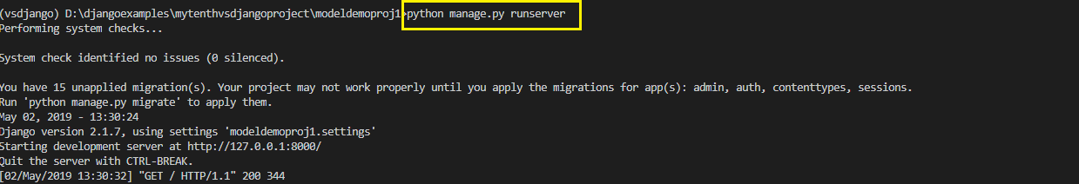
Step 13:Running The Server
To run our new modeldemoapp1 , go to the folder modeldemoproj1 by using cd command and type the runserver command in VS Code terminal
cd modeldemoproj1
python manage.py runserver.
The server runs and we’ll see output like the following output in the terminal window:

Slide 67
Step 14: Opening The Page
Ctrl+click the http://127.0.0.1:8000 URL in the terminal output
window to open default browser to that address. This will load the page
result.html with the following output

Slide 68
Step 14: Opening The Page
Ctrl+click Now type the url http://127.0.0.1:8000/showbooks and
this will load the will load the page showbooks.html with the following
output

